Slide 1

WHERE ARE YOU?
Presented by
Sharadha Mulugu
Priyanka Chigulla

Slide 2
About the app
This application is useful when a group of friends are travelling in separate vehicles to reach the same location and want to follow or know the progress of the other person, then they can track the path by using this app.

Slide 3
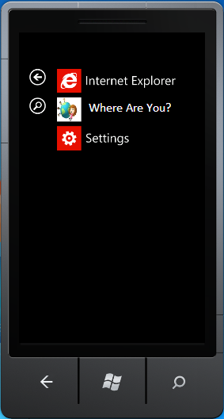

App Icon
This is the app icon

Slide 4
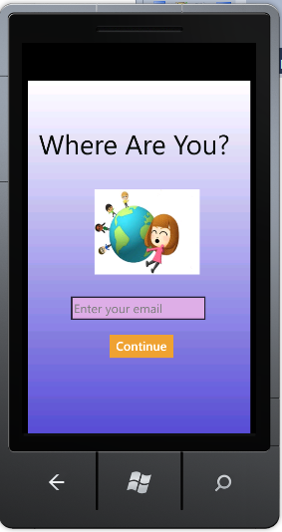
Home Page
This is the home page
of the app where the
user has to enter a
valid e-mail address to
continue.

Slide 5
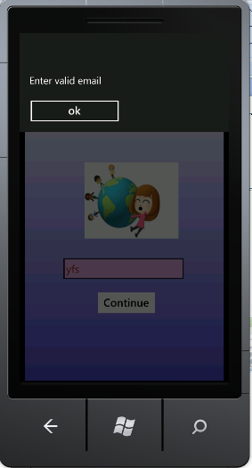
Home Page
If the user does not
enter a valid email then
a popup will be shown.

Slide 6
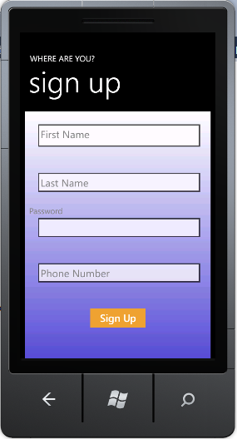
Sign Up
The user has to
enter their first name,
last name ,password
and phone number to
sign up.

Slide 7
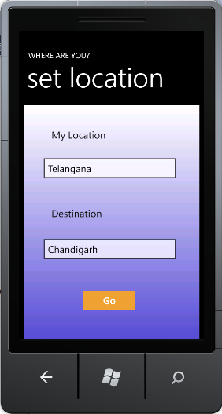
Set Location
The user needs to
set their location and
the destination .

Slide 8
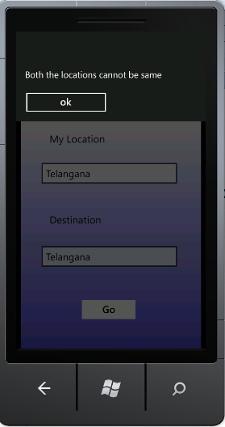
Set Location
If both the locations
are similar then it will
display a message
showing that they
can’t be same.

Slide 9
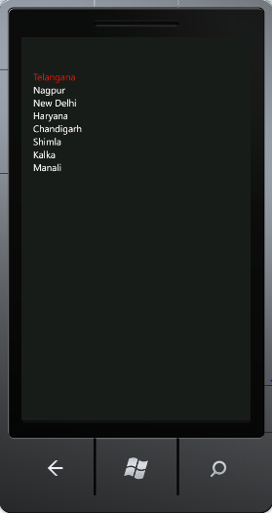
Set Location
List of the
Locations.

Slide 10
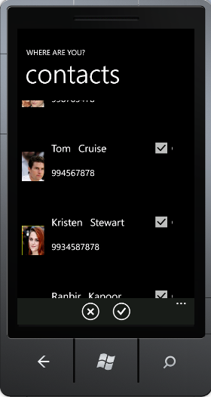
Contacts
List of the
Contacts.

Slide 11
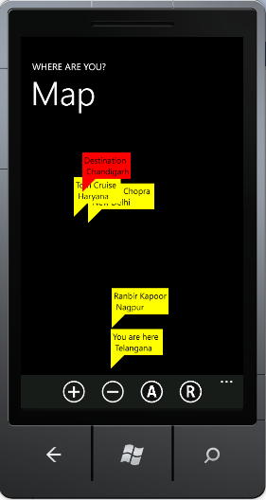
Map
The locations of
the selected contacts
will be shown on the
map.

Slide 12
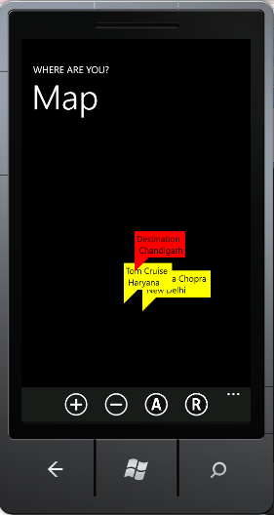

Options
Zoom in +
Zoom out –
Aerial Mode
Road Mode

Slide 13
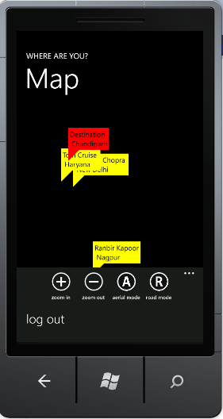

Logout
On clicking this
option the user will
be redirected to the
home page.

